Slide 1
Tutorial - 01
Web development intro

Slide 2
Introduction
This tutorial 01 provides an overview of :
What is website, how websites function, their structure, and the ins and outs of choosing a website name and selecting an online host to house your website.
What you need to get started with a website, and
What you don’t need and probably never need for your website etc.

Slide 3
terminologies
Website
WWW
Webpage
Web Browser
Internet
Search Engine
Protocols
Web Architectures

Slide 4
World Wide Web (www)
  The World Wide Web (or Web) is a name for the large amount of information that is available on computers connecting to the Internet. The information is stored on numerous web pages and web sites
  A website is a collection of linked web pages (plus their associated resources) that share a unique domain name. Each web page of a given website provides explicit links—most of the time in the form of clickable portion of text—that allow the user to move from one page of the website to another.
  The Origin of Web
  In 1989 the world wide web was invented by Sir Tim Berners-Lee. He was trying to find a new way for scientists to easily share the data from their experiments.
  Hypertext and the internet already existed at this point but no one had thought of a way to use the internet to link one document directly to another.
  Tim suggested three main technologies that meant all computers could understand each other which are HTML, URL and HTTP. He also made the world’s first Web Browser and Web Server.

Slide 5
First Website
  You can still see pages from the first web server online by visiting
  http://info.cern.ch/hypertext/WWW/TheProject.html

Slide 6
Why is the web so important?
The world wide web made it much easier for people to share information.
The world wide web opened up the internet to everyone, not just scientists.
It connected the world in a way that was not possible before and made it much easier for people to get information, share and communicate.
It allowed people to share their work and thoughts through social networking sites, blogs and video sharing.

Slide 7
The Difference Between Internet and World Wide Web
Many people think that the internet and the world wide web are the same thing. While they are closely linked, they are very different systems.
The internet is a huge network of computers all connected together. While The World Wide Web (‘www’ or ‘web’ for short) is a collection of webpages found on this network of computers.
Your web browser uses the internet to access the web

Slide 8
Web Browser
A Web browser is an application software which help to view, access and explorer the World Wide Web.
Often it comes already installed on your computer, just like other software ,
There are different types of browsers available today and the most popular web browser are:
    Mozilla Firefox,
    Google Chrome,
    Opera,
    Safari,
    Torch,
    Onion,
    Microsoft Internet Explorer etc.

Slide 9
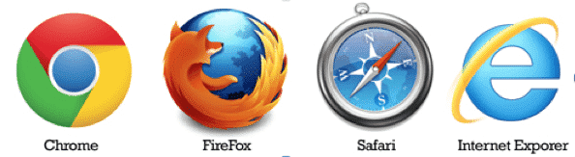
Different web browser icons

Slide 10
Uniform Resource Locator (URL)
URL stands for Uniform Resource Locator, and is used to specify addresses on the World Wide Web.
A URL is the network identification for any resource connected to the web (e.g., hypertext pages, images, and sound files).
The complete Web Address is known as a Uniform Resource Locator (URL) and is displayed in the Address bar of a browser
Typical URLs have the following format:
Protocol://hostname/other_information
Example:
https://www.github.com/brurredconsole

Slide 11
Protocols
  Protocols are standardized instructions for how to pass information back and forth between computers and devices
  The “http” at the start of a Web address stands for Hypertext Transfer Protocol.
  HTTP is a protocol, or set of rules and requirements for transferring and exchanging files on the Internet.
  Whenever you type a website like https://www.github.com/brurredconsole this protocol requests the website from github’s server and then receives a response with the HTML, CSS, and JavaScript of the website.

Slide 12
There are several other protocols that can be used on the Web, but HTTP is the most common, so common in fact that you don’t even need to type it in at the start of the address.
You can start the Web address by typing www, and your Web browser will automatically use the http protocol.
WWW is the acronym for the World Wide Web.
The www in a web address indicates that the site is part of the World Wide Web.

Slide 13
What is Website?
Website"(or simply a "site”) is a collection of webpages which are grouped and connected together based on a particular theme or related to a particular company.
Web Pages is a hypertext document which can be displayed in a web browsers such as Firefox, Google Chrome, Microsoft Internet Explorer or Edge, or Apple's Safari connected to the World Wide Web.
Web pages are created in a Markup language called HTML and can contain text, Graphic images, and links to other associated Web pages.
The idea behind hypertext is that instead of reading text in a rigid, linear structure (such as a book), you can skip easily from one point to another.
You can get more information, go back, jump to other topics, and navigate through the text based on what interests you at the time.

Slide 14
What is the difference between a website and Webpage?
A website may refers to a central location that contains more than one web page.
For example, www.sua.ac.tz is considered a website, which contains thousands of different pages, including about University page, Contact page ,Admission Page etc.

Slide 15
Types of Websites
Somebody may ask you the following … “I need to build a website ” … as a web designer your first reply will be what type of website?
Websites come in many different shapes and sizes and they can be a personal website, a corporate website for a company, a government website, an organization website, etc.
Ex: iaa.ac.tz
Deciding on which type of site you require depends on what you actually want the website to do
Websites are typically dedicated to a particular topic or purpose, ranging from entertainment and social networking to providing news and education.

Slide 16
Examples
Video sharing - YouTube/ Vimeo
Photo sharing – Instagram/Pinterest
Social network - Facebook/Twitter
Online shopping /e-commerce – Amazon
Forums – Jamii forums
Portal - Yahoo News/MSNBC
Question and answer site - Stack Overflow
Knowledgebase / Wiki Websites -Wikipedia
Online auctions - eBay
Blogging – Blogspot/Wordpress

Slide 17
Online Gambling/Betting - bet365
Dating Sites
Business Directory
Portfolio Websites
School /College Websites – www.sua.ac.tz
Search engine – Google/Bing
Weather forecasting , etc.
NOTE!
Technically, a website, or individual web page, can be Static or Dynamic.
A Static website contains information that does not change. It remains the same, or static, for every viewer of the site.
A Dynamic website contains information that changes, depending on the viewer, the time of the day, the time zone, the viewer's native language, and other factors.

Slide 18
Search Engine
Search engine is a website that helps you find other webpages.
A search engine is a special kind of website that helps users to find any webpages from other websites.
Examples of Search engines includes
Google,
Bing,
Yahoo, etc.

Slide 19
What is the difference between Browser and Search Engine?
A Browser is a software that retrieves and displays webpages;
A Search engine is a website that helps people find webpages from other websites.
The first thing you want to do with a browser is to find a web page to display.

Slide 20
Website Building Technologies
To build and develop a modern and fully functional website or other web application, you need multiple technologies.
These technologies can be hardware or software and it includes Servers, Database, Programming Language, Framework, Content Management System etc..
These technologies can be categorized as
Client-side Technologies
Server-side Technologies

Slide 21
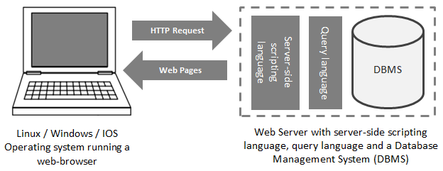

Slide 22
Client-side Technologies
Client-side (i.e. frontend) web development involves everything users see on their screens.
A client is one user of an application. Client’s can also be desktop computers, tablets, or mobile devices. There are typically multiple clients interacting with the same application stored on a server.
The major Client-side (frontend) technology technologies are:
  Hypertext Markup Language (HTML)
  Cascading Style Sheets (CSS)
  JavaScript (JS)

Slide 23
Hyper Text Markup Language (HTML)
  This is the building-blocks of web pages.
  It Controls Content & Structure of website
  It tells a browser how to display the content of web pages and allows images, text, videos, forms and other pieces of content to be available together into a webpage.
Cascading Style Sheets (CSS)
  This technology Controls Style (Appearance, Look and Feel) of website
  Font size, font color, font type, styling around images, page layout, mouse-over effects and more are all determined and driven by CSS.
JavaScript (JS)
  JS Controls various behaviors of website and makes web pages interactive.
  There are many JavaScript libraries (such as jQuery) and frameworks (such as Angular) for faster and easier web development.
NOTE:
Bootstrap is a helpful framework for managing HTML and CSS.

Slide 24
Server-Side Technologies
  A server is the place where the application code is stored
  System functions, methods, and data manipulation that you don’t want the clients to see happens at the server.
  Requests are made to the server from clients, and the server will gather the appropriate information and respond to those requests.
  The Server-side technologies includes a range of software solutions which are:
  Server-side Scripting Languages
  Database Management Systems (DBMS)
  Web Server Software
  Web Caching Software

Slide 25
Server-side Scripting Languages
These are programming languages which make website do stuff
Popular scripting languages and their major frameworks (in parentheses)
  PHP (Laravel, CodeIgnitor)
  Python (Django, Flask, Pylons)
  Java (Spring)
  Ruby (Ruby on Rails)
Database Management System
This is the place where website stores Data. There are two types of databases: relational and non-relational). The most common databases for web development:
  MySQL (relational)
  PostgreSQL (relational)
  MongoDB (non-relational, document)

Slide 26
Web Server Software
  a web application needs a server to handle requests from clients’ computers.
  Leading Web servers includes
    Apache (the most widely-installed Web server),
    Internet Information Server (IIS) from Microsoft's and
    Nginx (pronounced engine X) from NGNIX T
Web caching software
  Speed is one of the most important factors for a great user experience on the web.
  A web application needs a caching system to reduce the load on the database and to handle large amounts of traffic.
  The most widespread caching systems includes.
  Memcached
  Redis

Slide 27
Types of Web Caching
Remember how browsers save a copy of previously viewed sites?
Well, the computer stores them in a folder called the ‘cache’ .
Cache is a software/hardware component that stores data so that future requests for that data can be served faster
The data stored in a cache might be the result of an earlier computation or a copy of data stored elsewhere..
There are two types of Caches
Server Caching
Browser Caching
Browser caching is done on the client (user) side, while server caching is done on the server.

Slide 28
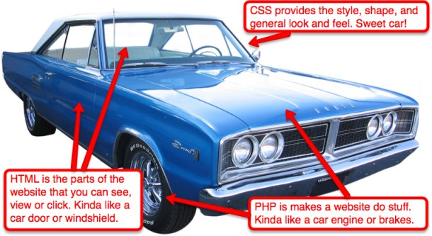
SUMMARY: Website building technologies

Slide 29
Web Software Solution Stack
Web solution stack is a combination of technologies or components needed to deliver a fully functioning website.
It is the “collection” of software required for Web development.
A web stack is usually comprised of:
  Operating system
  Database Software (application)
  Server-side Scripting Language
  Web Server

Slide 30
The most commonly used web-service software solution stack existing today are
LAMP (An acronym for Linux, Apache, MySQL and PHP)
WAMP (An acronym for Windows, Apache, MySQL and PHP)
MAMP (An acronym for Mac OS, Apache, MySQL and PHP)
XAMP (An acronym for Cross Platform, Apache, MySQL and PHP)
WISA (An acronym for Windows, IIS, SQL server, and ASP.NET.)
Note:
Cross Platform means the stack can be installed in any operating system such as Linux, Window, Mac OS etc.
LAMP, WAMP,MAMP and XAMP are all freely available software where as WISA is expensive, corporate and well-documented software.

Slide 31
Explanations …
The operating system acts as the central interface between the hardware and software components.
The web server helps in delivering the necessary documents to the clients who have requested them.
Databases help in permanently storing volumes of data needed for the web project.
The programming language or the server side script language interpreter operates on the client side and helps realize dynamic web applications of websites.

Slide 32
